Slide 1

72nd Annual
Mechanistic Insights into Emerging Therapeutic Platforms
October 16-20, 2025 / Gleneden Beach, OR, USA / www.montagnasymposium.org
Symposium Chair
Anthony Oro, M.D., Ph.D.
Symposium Co-organizers
Masayuki Amagai, M.D., Ph.D. Aimee Payne, M.D., Ph.D.
Symposium Co-directors
Sancy Leachman, M.D, Ph.D. Tamia Harris-Tryon, M.D., Ph.D. Dennis Roop, Ph.D.

Slide 2
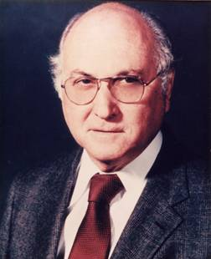
Eugene M. Farber, M.D. 1917–2000

Slide 3

Society for Investigative Dermatology
Eugene M. Farber
Travel Awards for Young Investigators
2025

Slide 4
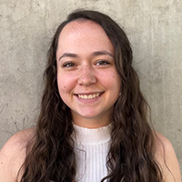
SID Eugene M. Farber Travel Award Winner
Kasidy Brown, B.S.
PhD Candidate
Oregon Health and Science University
^{Short Talk Session 4:}
“Dendritic cell intrinsic androgen receptor signaling inhibits anti-tumor immunity in melanoma”

Slide 5
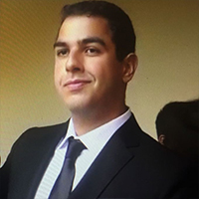
SID Eugene M. Farber Travel Award Winner
Edward Eid, M.D.
Scientist
Stanford University
^{Short Talk Session 2:}
“Enhancing the therapeutic potential of intravenous recombinant collagen VII, a protein replacement therapy, for recessive dystrophic epidermolysis bullosa”

Slide 6
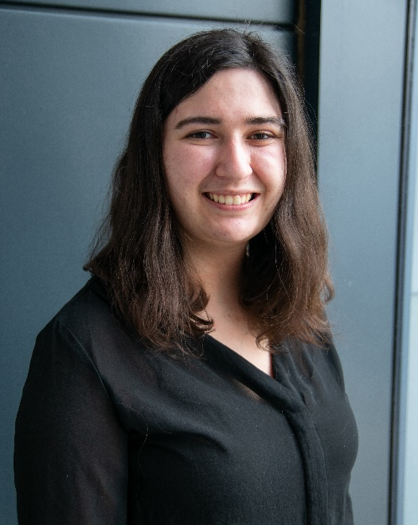
SID Eugene M. Farber Travel Award Winner
Caitlin Frazee, M.S.E.
Ph.D. Student
University of Pennsylvania
^{Short Talk Session 1:}
“Autoantibody-inducible Chimeric Antigen Receptors (CARs): a self-regulating immunotherapy for durable remission in pemphigus vulgaris”

Slide 7
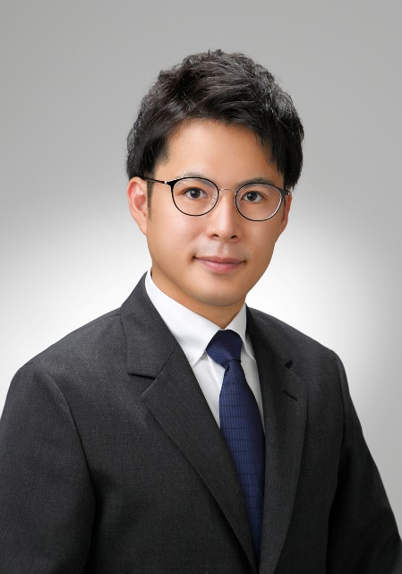
SID Eugene M. Farber Travel Award Winner
Ichiro Imanishi, DVM, Ph.D.
Postdoctoral Fellow
Icahn School of Medicine at Mount Sinai
^{Short Talk Session 3:}
“Spatial Transcriptomic Mapping Reveals a Basophil–Fibroblast Circuit Driving Chronic Type 2 Dermatitis”

Slide 8
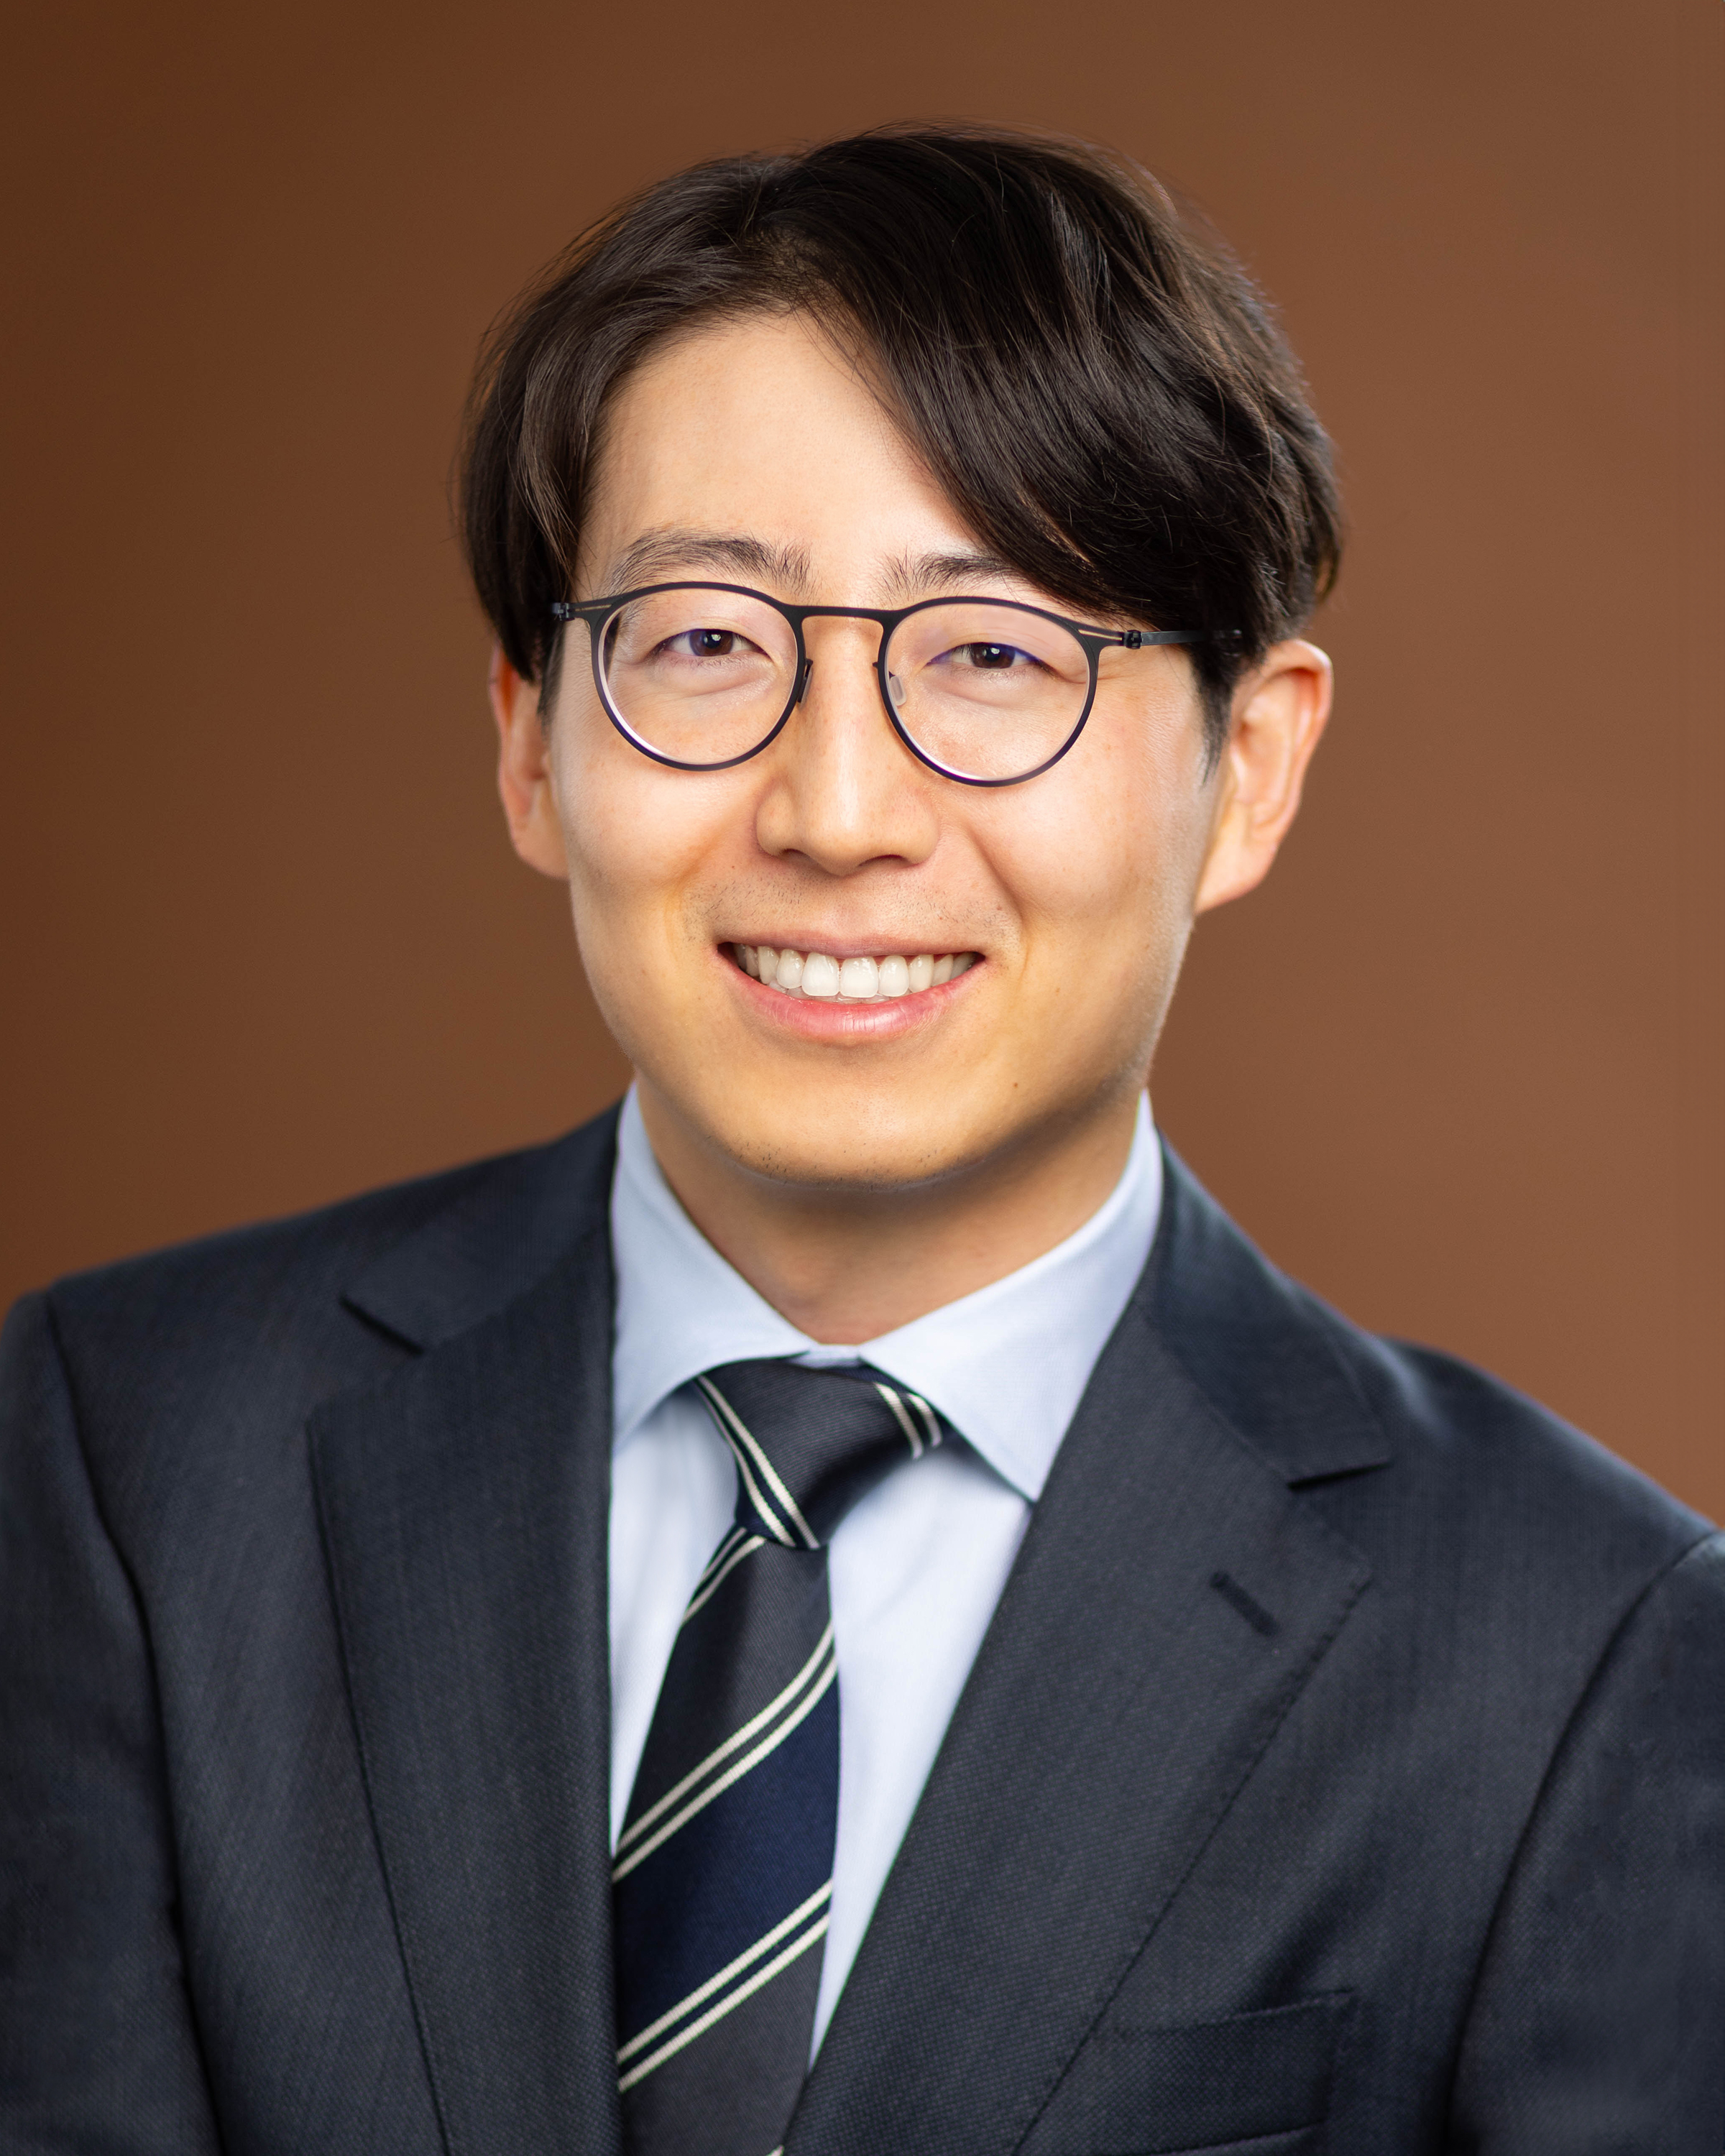
SID Eugene M. Farber Travel Award Winner
Bojing Jia, Ph.D.
MD/PhD Student
University of California, San Diego
^{Short Talk Session 4:}
“Spatial Genome Alignment: a spatial multi-omic technology for epigenetic mapping with dermatologic applications”

Slide 9
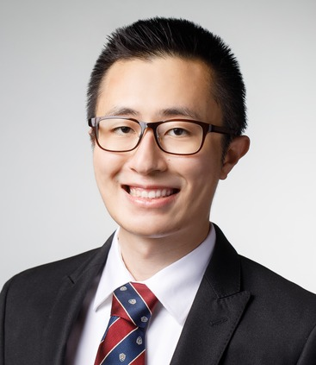
SID Eugene M. Farber Travel Award Winner
Jonathan Park, M.D., Ph.D.
Resident Physician
Northwestern University Feinberg School of Medicine
^{Short Talk Session 1:}
“Clonal hematopoiesis in primary and CAR T-cell related secondary T-cell malignancies”

Slide 10

Japanese Society for Investigative Dermatology Travel Award Winners
2025

Slide 11
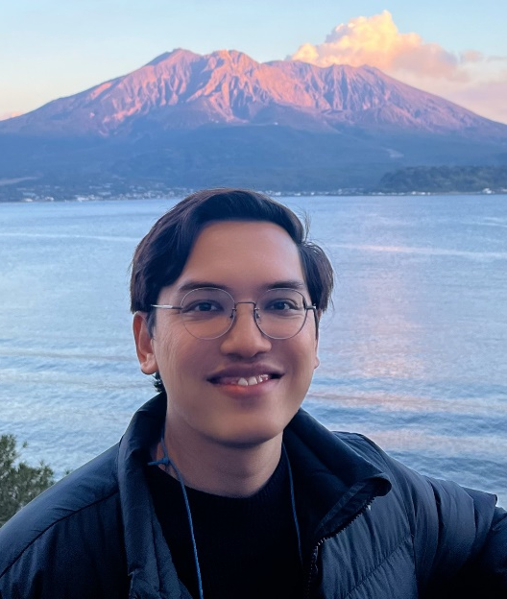
Japanese Society for Investigative Dermatology Travel Award Winner
Alafate Abudouwanli, M.S.
Ph.D. Candidate
Juntendo University Graduate School of Medicine
“Targeting the EGFR–autophagy axis in atopic dermatitis: therapeutic role of betacellulin”

Slide 12
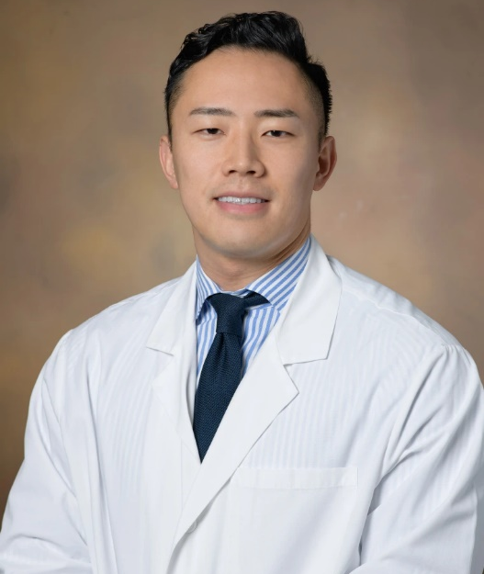
Japanese Society for Investigative Dermatology Travel Award Winner
Kento Takaya, M.D., Ph.D.
Postdoctoral Researcher
Keio University School of Medicine
“MARCKSL1⁺ Dendritic Cells Orchestrate Fibroblast-Mediated Fibrosis and Represent a Therapeutic Target for Regenerative
^{Wound Healing”}

Slide 13

Taiwanese Society for Investigative Dermatology Travel Award Winner
2025

Slide 14

Taiwanese Society for Investigative Dermatology Travel Award Winner
Han-Chi Tseng, M.D.
Assistant Professor
Kaohsiung Chang Gung Memorial Hospital
“The multifaceted and proinflammatory role of fibrinogen beta for various skin cells in hidradenitis suppurativa”

Slide 15

Korean Society for Investigative Dermatology Travel Award Winner
2025

Slide 16
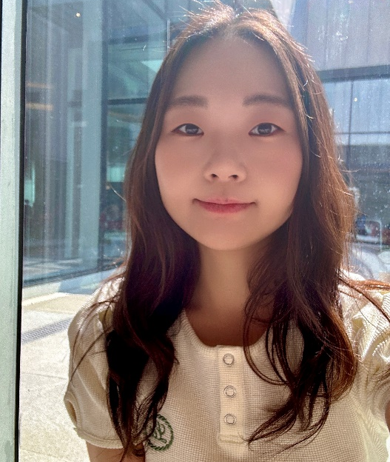
Korean Society for Investigative Dermatology Travel Award Winner
A Yeong Lee, Ph.D.
Postdoctoral Researcher
Yonsei University College of Medicine
“Spatial immune microenvironment of clonal CXCL13⁺CD4⁺ T cells and Tregs within tertiary lymphoid structures of chronic skin lesions in pemphigus”

Slide 17

European Society for Dermatologic Research Travel Award Winners
2025

Slide 18
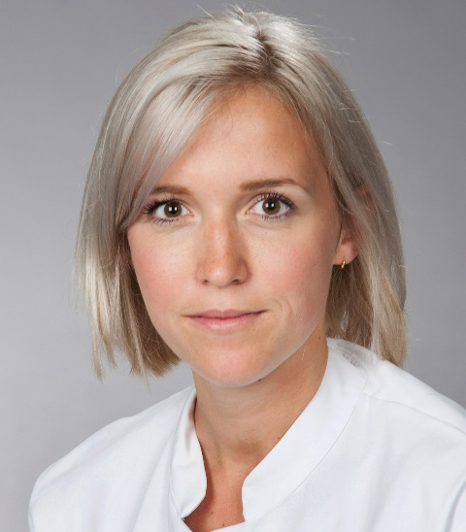
European Society for Dermatological Research Travel Award Winner
Caroline Mann, M.D., Ph.D.
Assistant Professor
Johannes Gutenberg University Medical Center Mainz
“A shift towards a type I immune response in chronic atopic dermatitis favours an IL-15 dependent tissue resident memory cell niche”

Slide 19
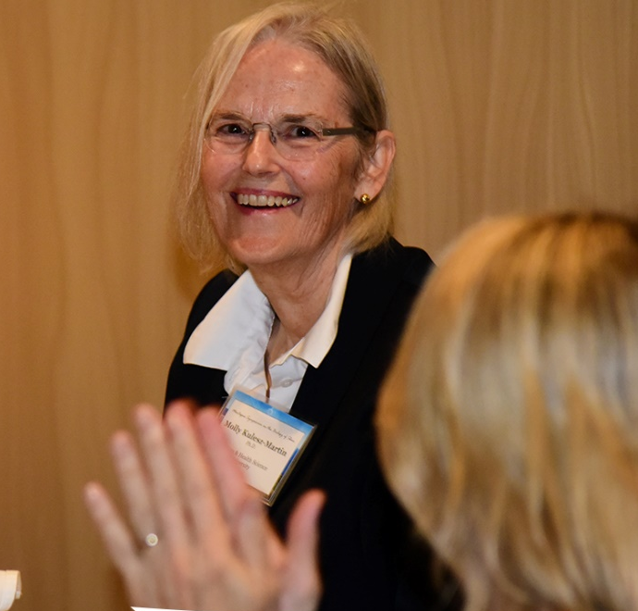
Molly Kulesz-Martin, Ph.D. Director’s Awards
2025
In honor of Montagna Symposium Director Emeritus, Molly Kulesz-Martin, Ph.D.

Slide 20
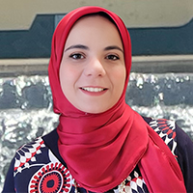
Molly Kulesz-Martin, Ph.D., Director’s Award
Noha Ahmed, M.D., Ph.D.
Senior Researcher
The University of Alabama at Birmingham
^{Short Talk Session 2:}
“Targeting FKBPs to Promote Regenerative Wound Healing”

Slide 21
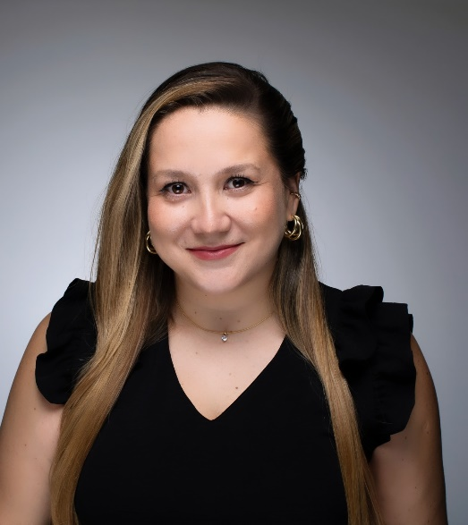
Molly Kulesz-Martin, Ph.D., Director’s Award
Carolina Cabalín, Ph.D.
Postdoctoral Research Fellow
Weill Cornell Medicine
“Modeling PD-1 driven cutaneous immune related adverse events through memory T cells”

Slide 22
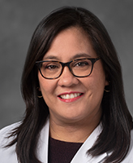
Molly Kulesz-Martin, Ph.D., Director’s Award
Cristina de Guzman Strong, Ph.D.
Associate Professor
Henry Ford Health + Michigan State University Health Sciences
^{Short Talk Session 3:}
Translating knowledge of human skin evolution and genetic innovation to develop new treatments for the skin barrier

Slide 23
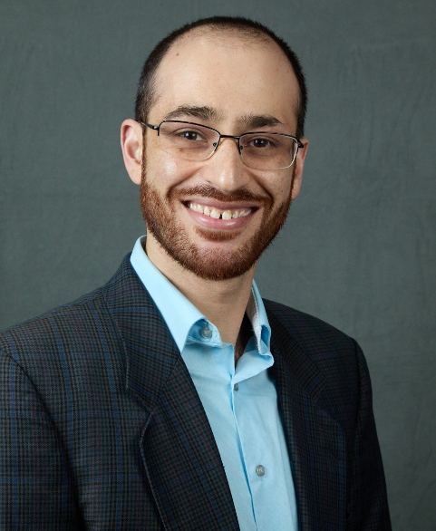
Molly Kulesz-Martin, Ph.D., Director’s Award
Umber Dube, M.D., Ph.D.
Assistant Professor
UC San Diego
^{Short Talk Session 1:}
“The Impact of Hematopoietic Stem Cell-Mediated Ex Vivo Gene Therapy on the Skin in Cystinosis”

Slide 24
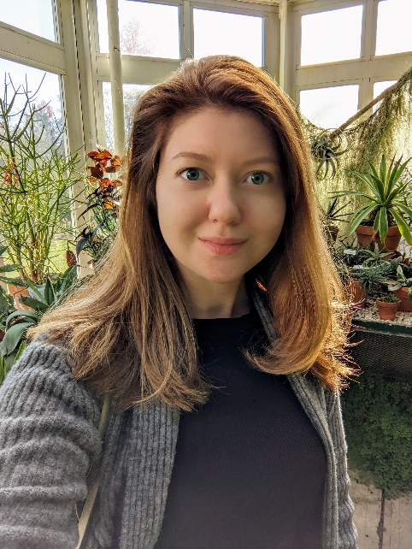
Molly Kulesz-Martin, Ph.D., Director’s Award
Anastasiya Gorkun-Roeder, Ph.D.
Research Assistant Wake Forest Institute for Regenerative Medicine
“Skin Organoids in Bioprinted Skin Implants Facilitate Human-Like Epidermis and Induce Pigmentation in Mouse Wound Model”

Slide 25
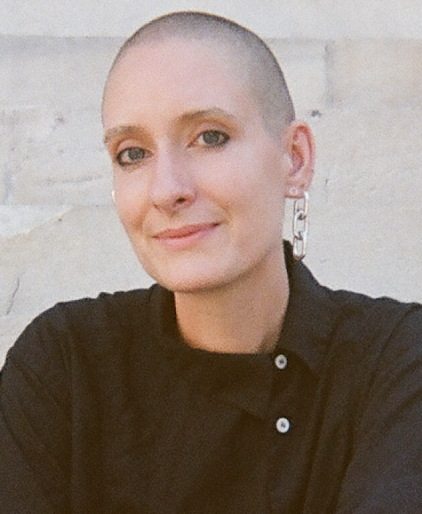
Molly Kulesz-Martin, Ph.D., Director’s Award
Poppy Gould, Ph.D.
Postdoctoral Research Fellow
NYU Langone Health
^{Short Talk Session 3:}
“Restoring aberrant CD74 signaling in hidradenitis suppurativa keratinocytes with Plerixafor treatment”

Slide 26
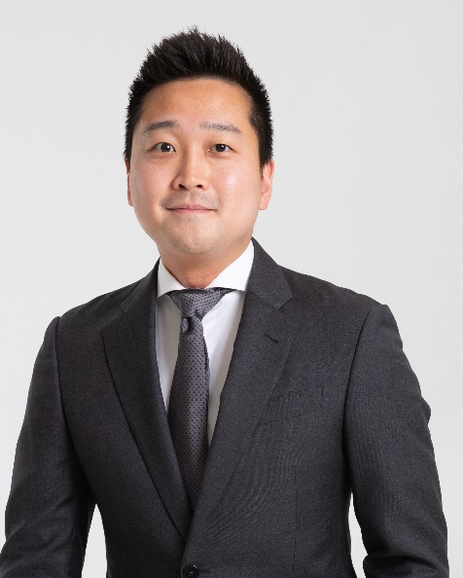
Molly Kulesz-Martin, Ph.D., Director’s Award
Jinwoo Lee, M.D., Ph.D.
Instructor of Dermatology
Stanford University
^{Short Talk Session 5:}
“Novel autoantibodies target hotspots on the XIST ribonucleoprotein complex in female-biased autoimmune diseases”

Slide 27
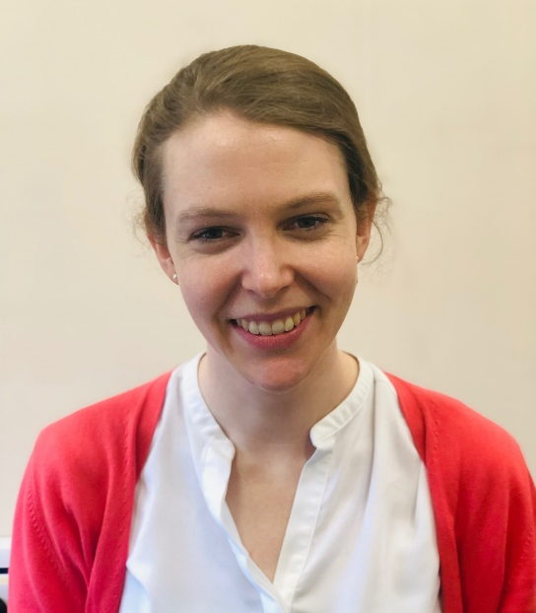
Molly Kulesz-Martin, Ph.D., Director’s Award
Sheila McSweeney, M.B., MSt, MSc, Ph.D.
NIHR Academic Clinical Lecturer in Dermatology
King's College London/London School of Hygiene and Tropical Medicine
“Identification of metabolic dysregulation in solar urticaria – a novel therapeutic strategy for photosensitive skin disease?”

Slide 28
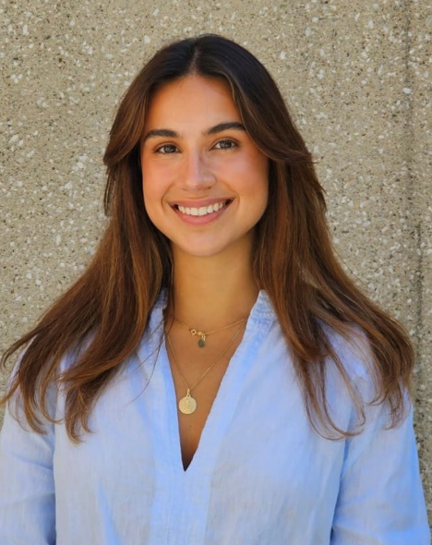
Molly Kulesz-Martin, Ph.D., Director’s Award
Gemma Nomdedeu-Sancho, M.S.
PhD Candidate
Wake Forest Institute for Regenerative Medicine (WFIRM)
“A Tunable Melanoma-Skin Organoid platform to Model Tumor-Intrinsic and Microenvironmental Drivers of Progression and Therapy Response”

Slide 29
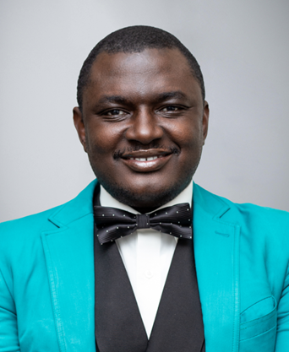
Molly Kulesz-Martin, Ph.D., Director’s Award
Tolulope Omolekan, Ph.D.
Postdoctoral Researcher
Louisiana State University and A&M College
“Discovery of Novel Indole-Isoxazole-Carboxylic Acid Scaffold Targeting p70S6K1 and CDK2/4/6 as Inhibitors for Antimelanoma Therapy”

Slide 30
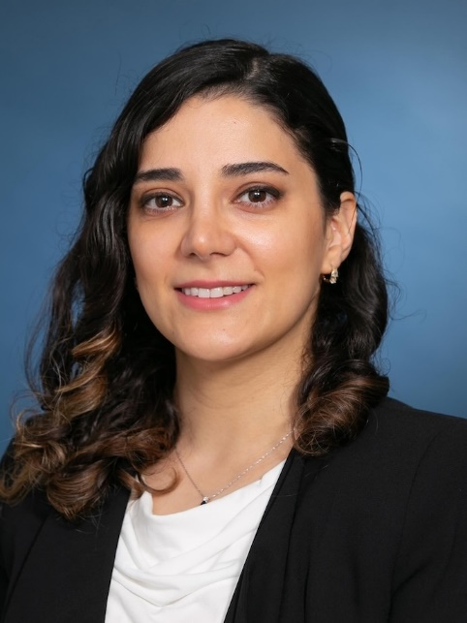
Molly Kulesz-Martin, Ph.D., Director’s Award
Fateme Rajabi, M.D.
Postdoctoral Researcher
University of Massachusetts Chan Medical School
“IL-15Rα Signaling in Keratinocytes Sustains Autoreactive Trm Cells and Drives Vitiligo Persistence”

Slide 31
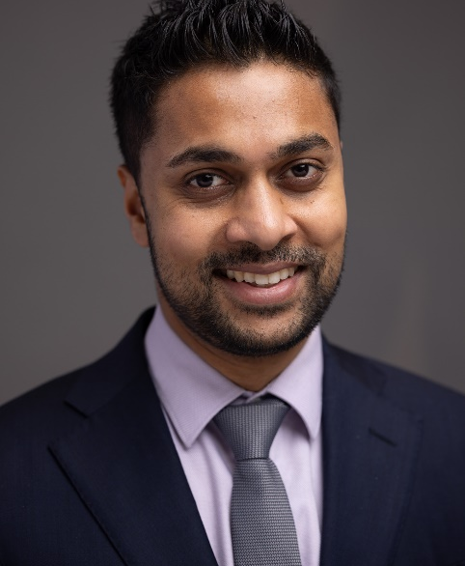
Molly Kulesz-Martin, Ph.D., Director’s Award
Ravi Ramessur, M.D., Ph.D.
Postdoctoral Researcher
University of Pennsylvania
“GLP1R agonism and psoriatic disease: genetic evidence for a disease-specific immunomodulatory effect”

Slide 32
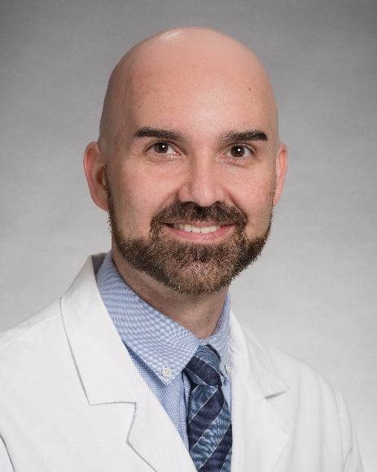
Molly Kulesz-Martin, Ph.D., Director’s Award
Cory Simpson, M.D., Ph.D., FAAD
Assistant Professor of Dermatology
University of Washington
^{Short Talk Session 2:}
“Organotypic models of genetic skin blistering diseases reveal rational therapeutic strategies and guide drug repurposing”

Slide 33
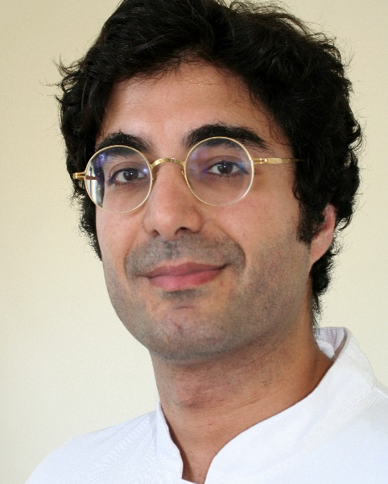
Molly Kulesz-Martin, Ph.D., Director’s Award
Farzan Solimani, M.D.
Associate Research Scientist
Columbia University
^{Short Talk Session 1:}
“Engineered T cells for autoimmunity: emerging data from human clinical trials”

Slide 34
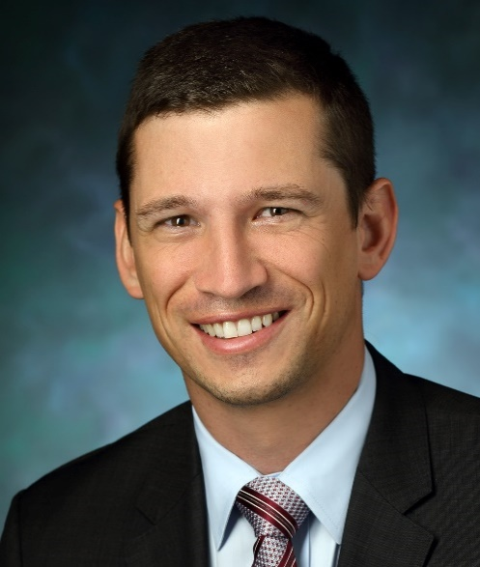
Molly Kulesz-Martin, Ph.D., Director’s Award
Joel Sunshine, M.D., Ph.D.
Assistant Professor
Johns Hopkins School of Medicine
^{Short Talk Session 4:}
“Non-viral gene delivery to restore antigen presentation in melanoma”

Slide 35
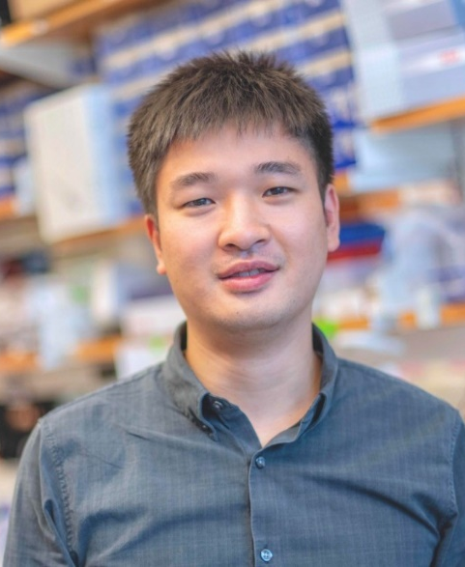
Molly Kulesz-Martin, Ph.D., Director’s Award
Qi Tang, Ph.D.
Assistant Professor
UMass Chan Medical School
“RNAi: A New Therapeutic Avenue in Dermatology”

Slide 36
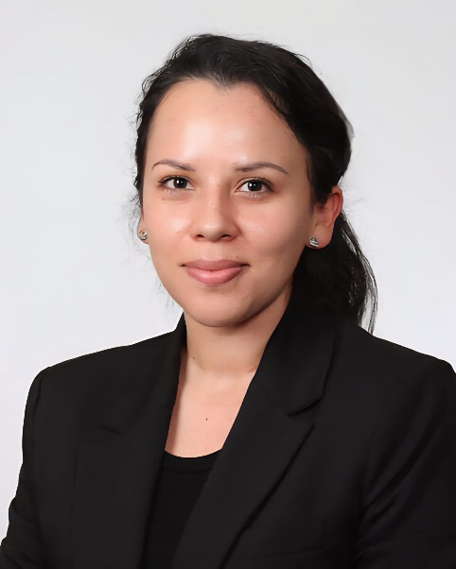
Molly Kulesz-Martin, Ph.D., Director’s Award
Karla Valdivieso, Ph.D.
Postdoctoral Research Fellow
Mayo Clinic
“Induction of rapid-onset senescence is integral to healing”

Slide 37
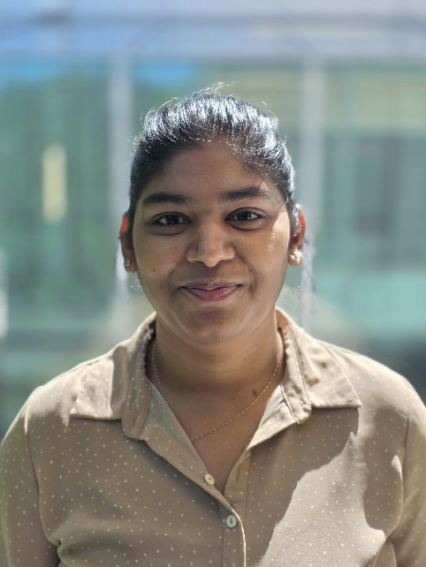
Molly Kulesz-Martin, Ph.D., Director’s Award
Priyanka Verma, Ph.D.
Postdoctoral Research Fellow
University of Michigan
“Flavin-Containing Monooxygenase 3 (FMO3): A Central Player in the Gut-multiorgan fibrosis”
“p300 inhibition Attenuates Fibrosis and Senescence”

Slide 38
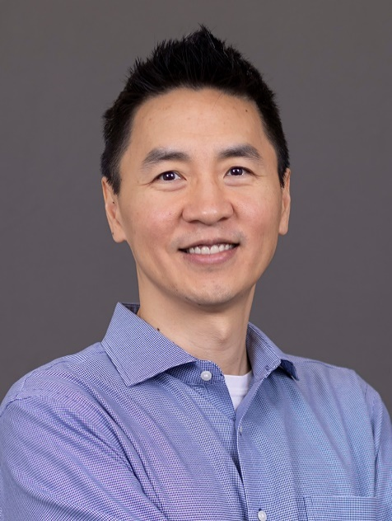
Molly Kulesz-Martin, Ph.D., Director’s Award
Richard Wang, M.D., Ph.D.
Professor of Dermatology
University of Colorado Anschutz Medical Campus
^{Short Talk Session 5:}
“Advancing Lipid Nanoparticle (LNP)-mRNA and LNP-siRNA Therapies Using In Vivo Models of Xeroderma Pigmentosum and Psoriasis”

Slide 39
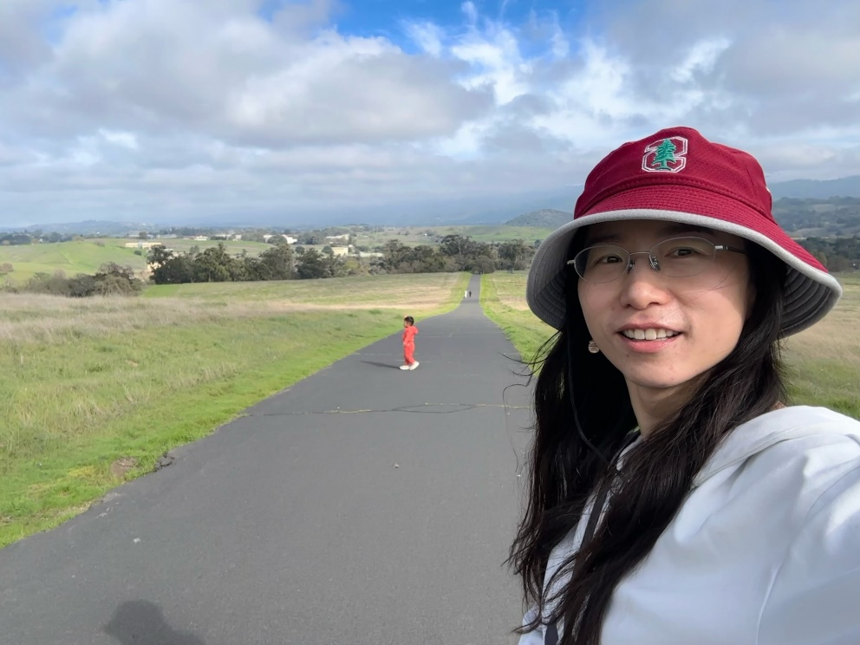
Molly Kulesz-Martin, Ph.D., Director’s Award
Ying Yang, Ph.D.
Postdoctoral Scholar
Stanford University
“A spatiotemporal and machine-learning platform facilitates the manufacturing of hPSC-derived esophageal mucosa for RDEB Patients”

Slide 40

Oregon Dermatology Society Director’s Award
2025

Slide 41
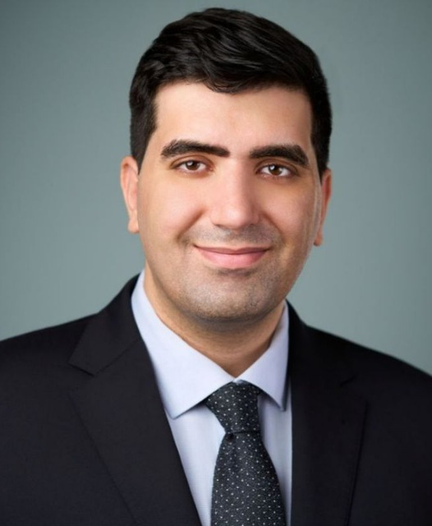
Oregon Dermatology Society Director’s Award
Hossein Akbarialiabad, M.D., M.B.A., Mmed
Research Fellow
University of Utah
“Closed-Loop Dermatologic Therapy Using Biosensors and Adaptive Delivery of Biologics and Small Molecules”

Slide 42

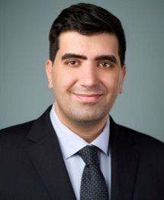
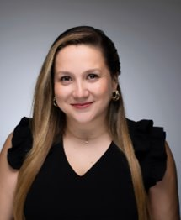
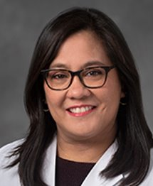
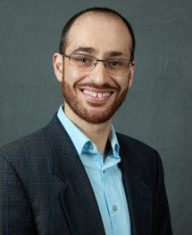
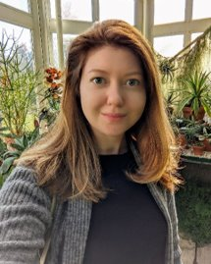
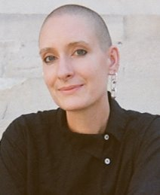
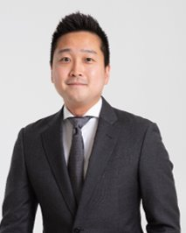
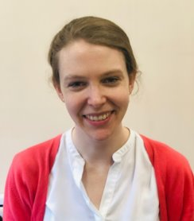
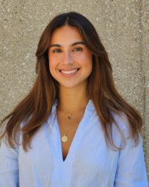
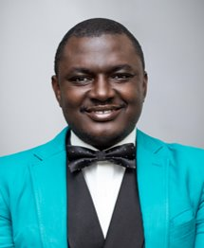
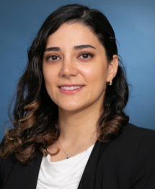
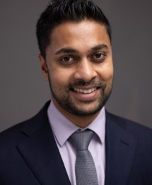
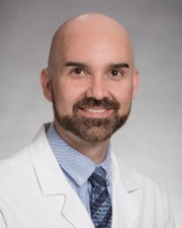
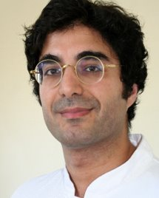
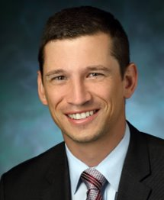
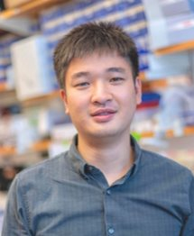

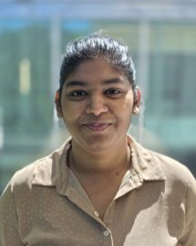



Congrats to our 2025 Travel Awardees!
Molly Kulesz-Martin, Ph.D. Director’s Award
Noha Ahmed, Hossein Akbarialiabad, Carolina Cabalin, Cristina de Guzman Strong, Umber Dube, Anastasiya Gorkun-Roeder, Poppy Gould, Jinwoo Lee, Sheila McSweeney, Gemma Nomdedeu-Sancho, Tolulope Omolekan, Fateme Rajabi, Ravi Ramessur, Cory Simpson, Farzan Solimani, Joel Sunshine, Qi Tang, Karla Valdivieso, Priyanka Verma, Richard Wang, Ying Yang
Matching Gift: $2,500
Please join us in making these awards possible!

